Slide 1

NeRF Uncertainty in Code
Minjae Lee

Slide 2
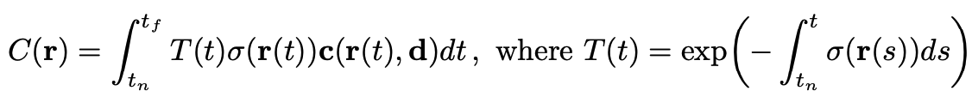
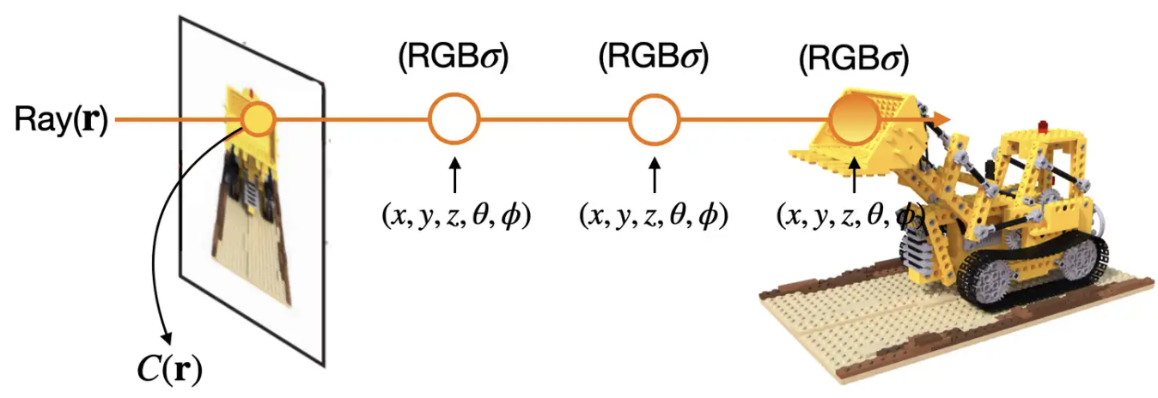
Volume Rendering Equation

Slide 3
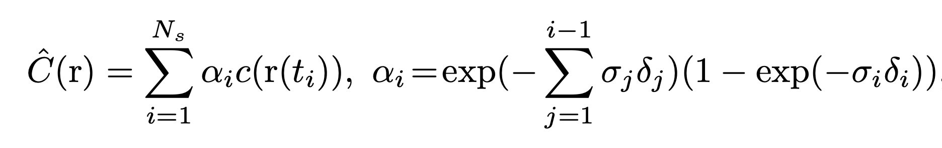
Equation in code

Slide 4
Distinguish original img and flip img
Make flip folder -> inefficient
Command -> make flip images and json file
In the Dataset class, I created and returned a dictionary related to images, and I added flip_check to it.
Notes:
처음에 플립한 이미지들만 가진 폴더를 만들어지게 하여서 이미지 자체에 차원을 추가해서 labeling을 해서 하려고 했음. 하지만 이러면 넘겨줘야 하는 인자가 너무 많아지고 비효율적임
그래서 명령어를 치면, r_2 -> r_2_flip 과같이 모든 이미지에 적용이 되며, json 파일도 자동으로 업데이트 되게 하였음.
데이터 로더에서 이미지 관련 딕셔너리를 만들고 리턴하는데 이에 flip_check 를 추가로 만들어줬음.
In the data loader, I created and returned a dictionary related to images, and I added flip_check to it.

Slide 5
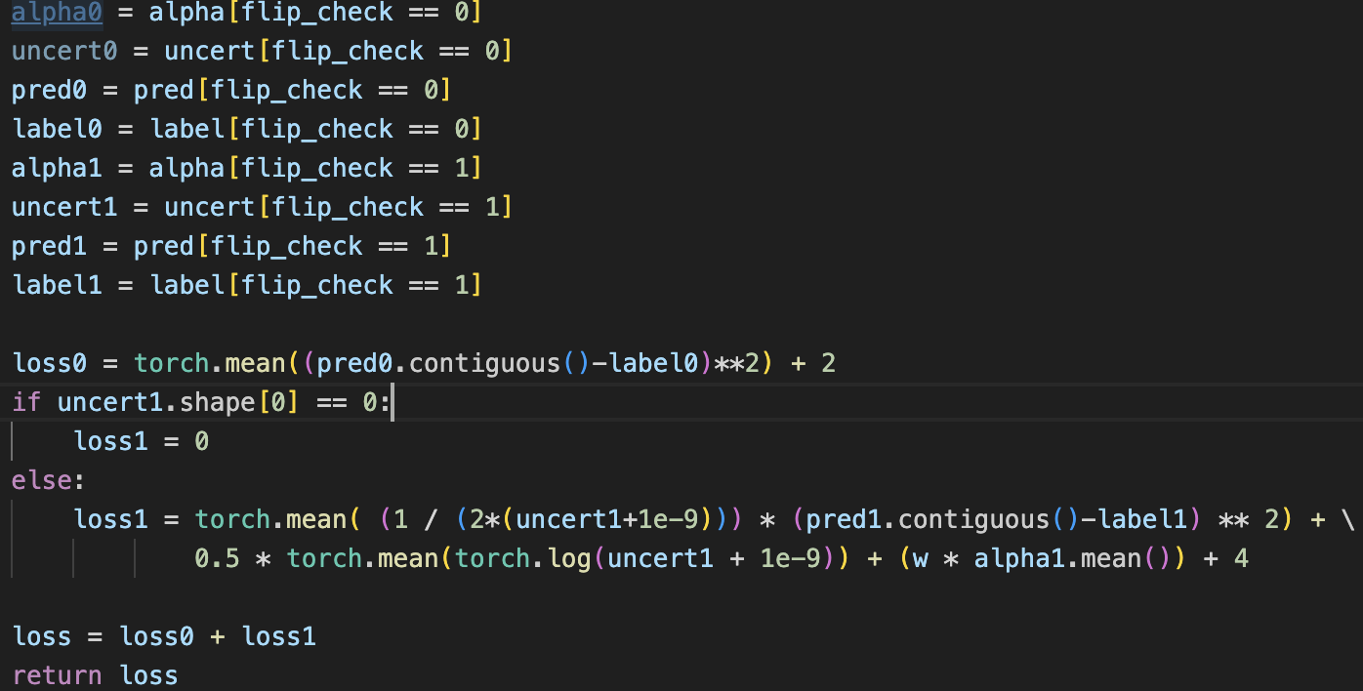
Consider uncertainty only one side view in code
Method 1: Calculate loss0 and loss 1 separately

Slide 6
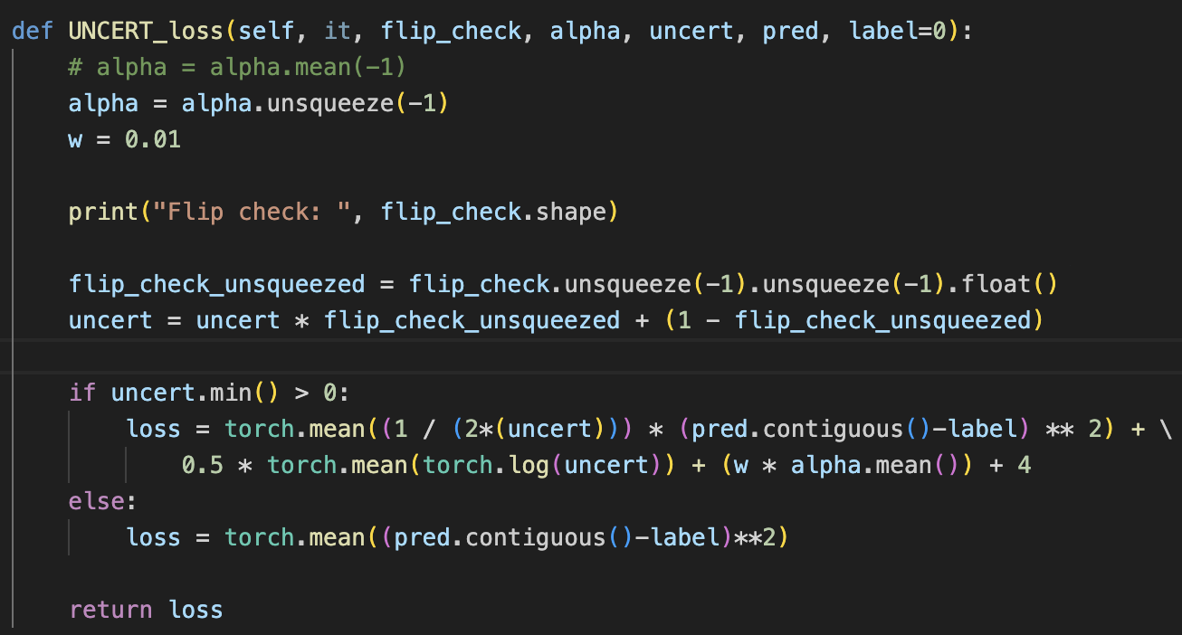
Consider uncertainty only one side view in code
Method 2: Define only one loss to consider alpha term together

Slide 7
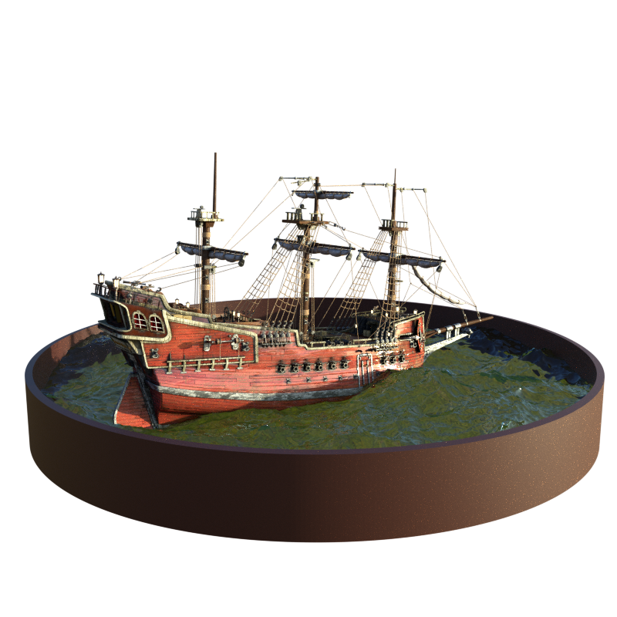
Experiment Result
( Ship scene / Epoch = 50k )
 | PSNR | SSIM | LPIPS
8_ori wo u | 17.548 | 0.698 | 0.352
16_flip wo u | 21.898 | 0.769 | 0.216
16_flip w u m1 | 9.718 | 0.532 | 0.555
16_flip w u m2 | 11.312 | 0.612 | 0.492
16_flip w u all | 22.047 | 0.771 | 0.225

Slide 8
Experiment Result
( Ship scene / Epoch = 50k ) + pretrained 10k
 | PSNR | SSIM | LPIPS
8_ori wo u | 17.548 | 0.698 | 0.352
16_flip wo u | 21.898 | 0.769 | 0.216
16_flip w u m1 | 20.501 | 0.732 | 0.271
16_flip w u m2 | 20.861 | 0.741 | 0.257
16_flip w u all | 22.047 | 0.771 | 0.225

Slide 9
Experiment Result
( Ship scene / Epoch = 50k ) + pretrained 10k + modify
 | PSNR | SSIM | LPIPS
8_ori wo u | 17.548 | 0.698 | 0.352
16_flip wo u | 21.898 | 0.769 | 0.216
16_flip wu m1 | 22.273 | 0.771 | 0.219
16_flip wu all | 22.047 | 0.771 | 0.225
16_flip wu 0.005 | 22.132 | 0.773 | 0.218
m1 : use one loss and make uncertainty value 0.01 at original images
0.005 : change the min val of uncert 0.01 to 0.005

Slide 10
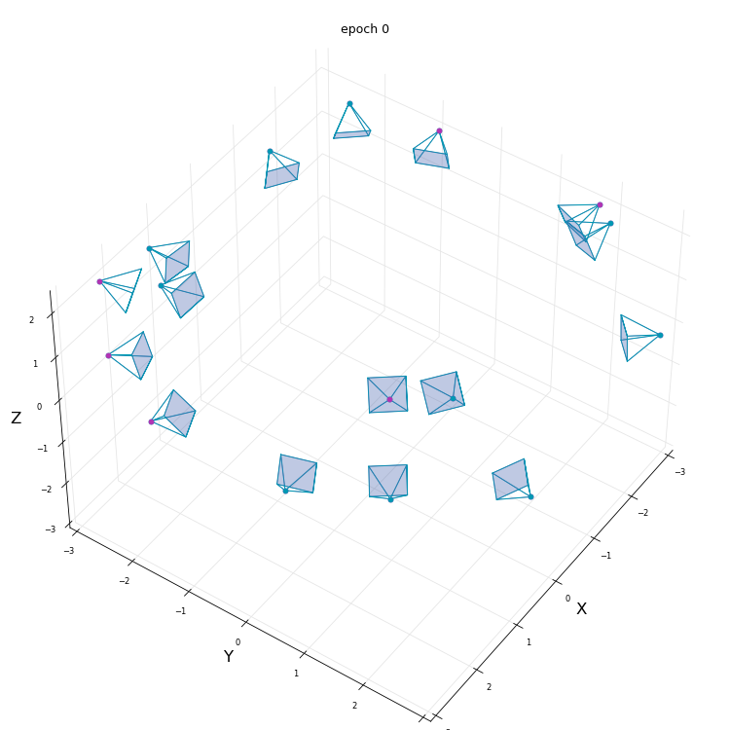
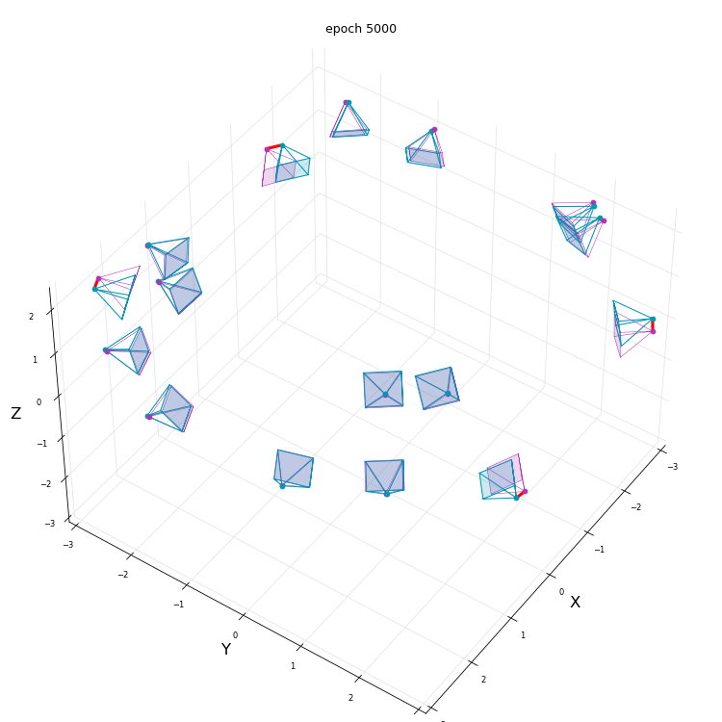
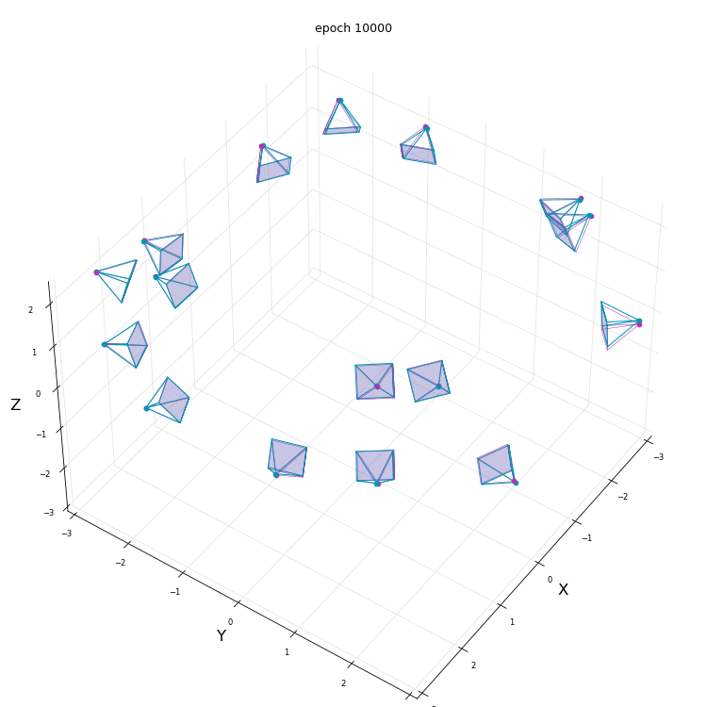
Bundle adjustment only one side view
Visualization of no fix original camera pose

Slide 11

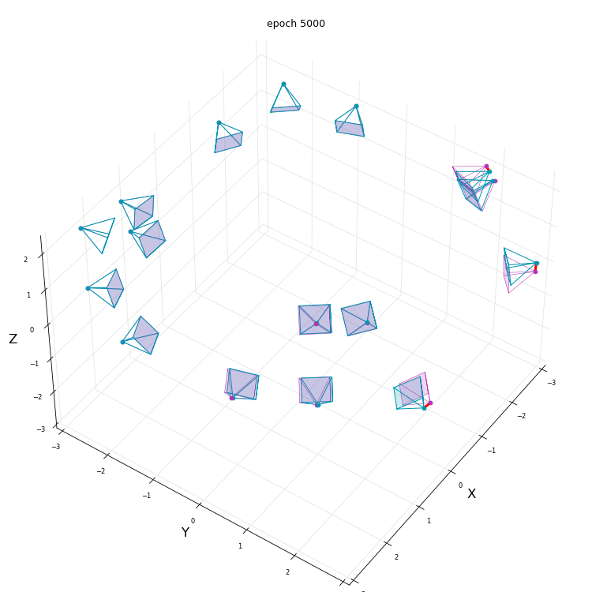
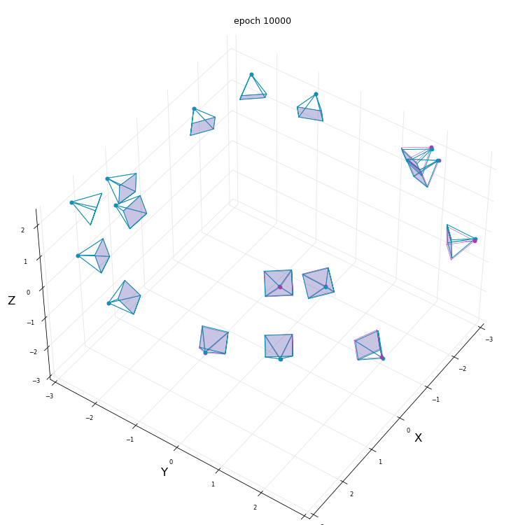
Bundle adjustment only one side view
Visualization of fixed original camera pose

Slide 12
Experiment Result
( Ship scene / Epoch = 50k ) + pretrained 10k + modify
 | PSNR | SSIM | LPIPS
16_flip wu both side | 22.273 | 0.771 | 0.219
16_flip wu one side | 22.273 | 0.771 | 0.219
16_flip wu no barf | 22.125 | 0.770 | 0.218

Slide 13
Final Ship Experiment Result
( Ship scene / Epoch = 50k ) + pretrained 10k + modify
 | PSNR | SSIM | LPIPS
base | 17.548 | 0.698 | 0.352
our | 22.273 | 0.771 | 0.219
upper | 25.151 | 0.810 | 0.187

Slide 14
About another Dataset
- Epoch = 50k
- Base : 8 images / pose fix / no uncert
Pose : 16 images / one side pose fix / one side no uncert /
10k pretrained
Upper : 16 images / pose fix / no uncert

Slide 15
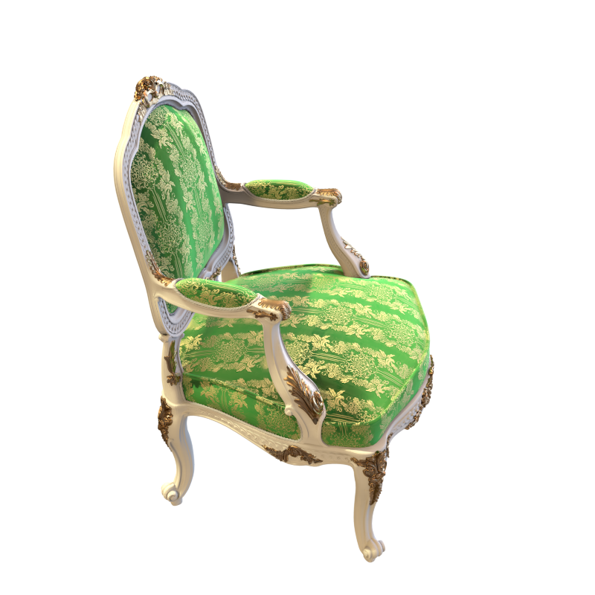
Experiment Result
( Chair scene )
 | PSNR | SSIM | LPIPS
8_ori wo u | 20.086 | 0.829 | 0.244
8_ori w u | 19.405 | 0.808 | 0.195
16_flip wo u | 24.765 | 0.904 | 0.098
16_flip w u | 24.641 | 0.901 | 0.101
16_upper wo u | 27.276 | 0.913 | 0.080
16_upper w u | 26.413 | 0.899 | 0.91
* Wo u = no uncertainty / wu = uncertainty and barf only one side

Slide 16
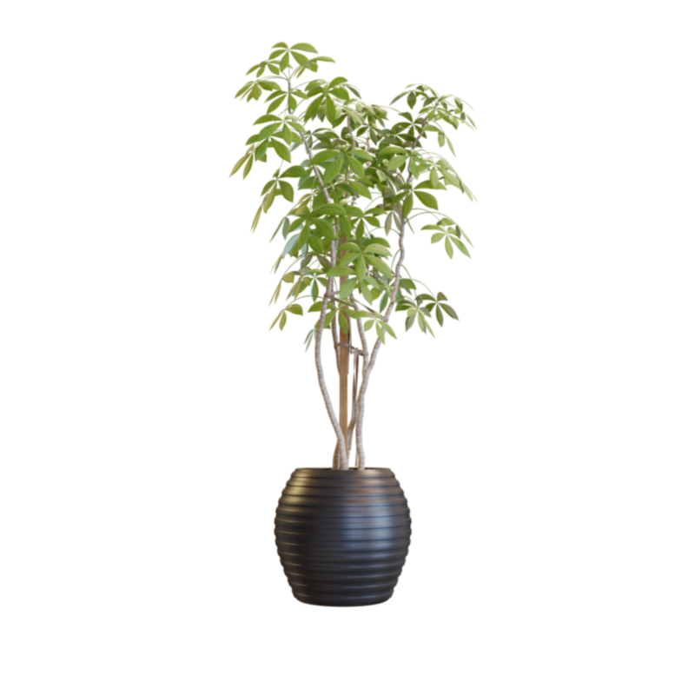
Experiment Result
( ficus scene)
 | PSNR | SSIM | LPIPS
8_ori wo u | 17.021 | 0.817 | 0.269
8_ori w u | 14.865 | 0.732 | 0.290
16_flip wo u
16_flip w u
16_upper wo u | 23.205 | 0.906 | 0.083
16_upper w u | 23.372 | 0.907 | 0.082

Slide 17
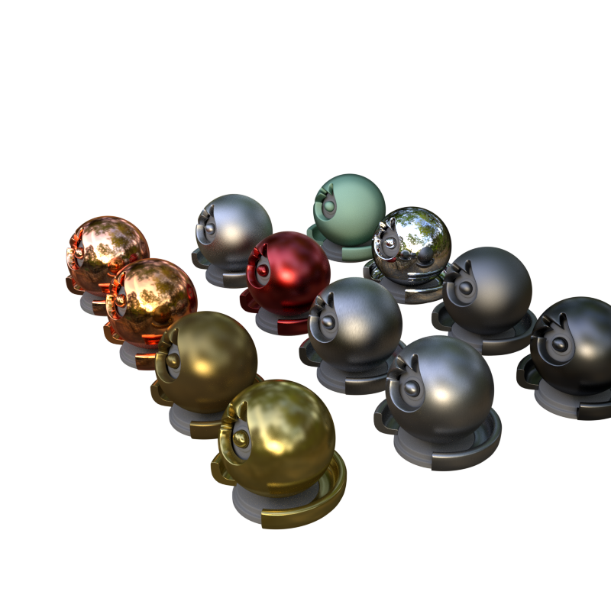
Experiment Result(barf)
( materials scene)
 | PSNR | SSIM | LPIPS
8_ori wo u
8_ori w u | 20.139 | 0.818 | 0.209
16_flip wo u
16_flip w u | 19.643 | 0.833 | 0.157
16_upper wo u
16_upper w u | 24.300 | 0.892 | 0.109
* Flip 시 view에따라 공의 색깔이 달라져서 psrn 감소 하지만 ssim, lpips는 잘 잡은듯

Slide 18
Experiment Result(nerf)
( materials scene)
 | PSNR | SSIM | LPIPS
8_ori wo u
8_ori w u
16_flip wo u
16_flip w u
16_upper wo u
16_upper w u

Slide 19
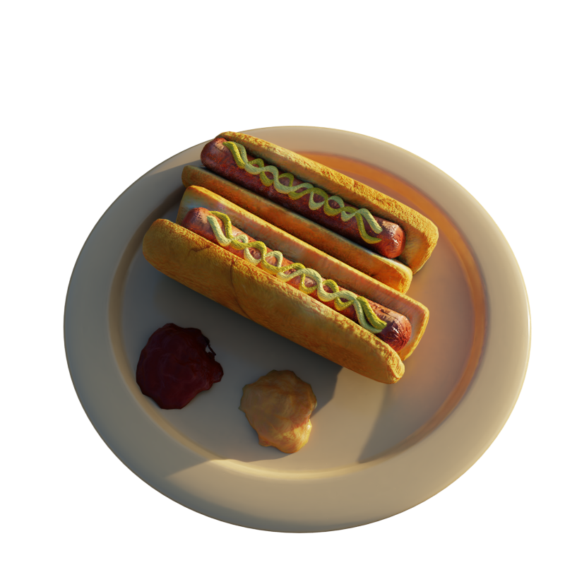
Experiment Result
( hotdog scene)
 | PSNR | SSIM | LPIPS
8_ori wo u
8_ori w u
16_flip wo u
16_flip w u
16_upper wo u
16_upper w u

Slide 20
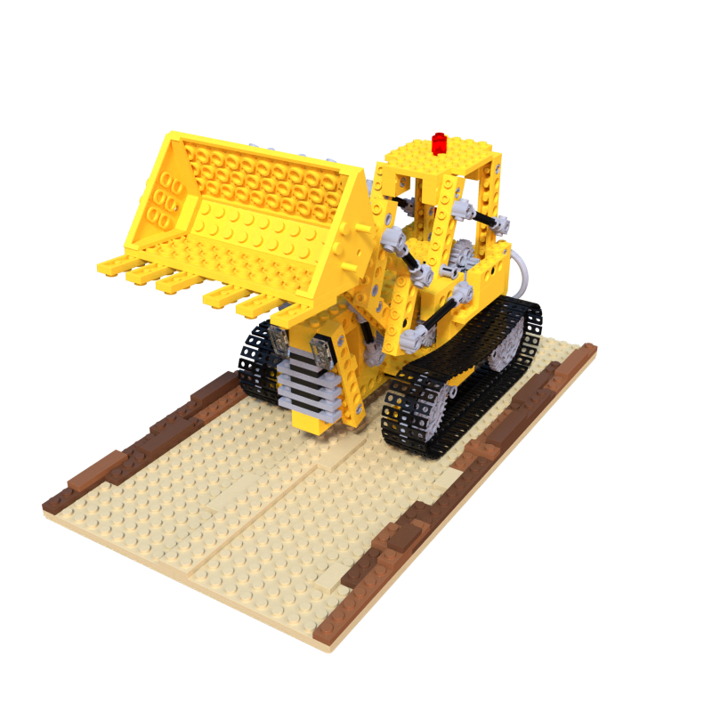
Experiment Result
( lego scene)
 | PSNR | SSIM | LPIPS
8_ori wo u
8_ori w u
16_flip wo u
16_flip w u
16_upper wo u
16_upper w u

Slide 21
앞에것은 200장의 평균이고, unobserved view를 선택해서 하면 그부분은 성능이 올라감

Slide 22
Thank you for listening!

